Slide 1

Property Price Prediction
Presented By : Harikrishnan M

Slide 2
Problem Statement
Our objective is to develop a predictive model that can accurately estimate the price of a property based on its features.
If anyone interested to purchase an asset in Bangalore he/she can look into the predicted price for further clarifications.
We used the dataset which consists 13320 property ( rows ) with prices in lakhs from kaggle to build the model.
Here our target variable is price which is a continuous variable, So this is a regression problem.
There were 9 features in total and even after basic data processing the base model accuracy was in negative numbers.
The basic data processing includes duplicate cleaning, null value treatments, data type matching, location segregation.
Thus we have done a lot of advanced data processing on this to make the model apt

Slide 3
Features overview
1. area_type : Describes the type of area the property is located in (e.g., Super build up Area, Built-up Area, Plot Area, Carpet Area).
2. availability : Indicates from which date the property will be available for purchase.
3. location : Specifies the location of the property in Bangalore.
4. size : Represents the size or number of rooms in the property (e.g., 2 BHK, 3 BHK).
5. society : Indicates the name of the society or housing complex the property belongs to.
6. total_sqft : Specifies the total square footage of the property.
7. bath : Represents the number of bathrooms in the property.
8. balcony : Indicates the number of balconies available in the property.
9. price : Represents the price of the property.

Slide 4
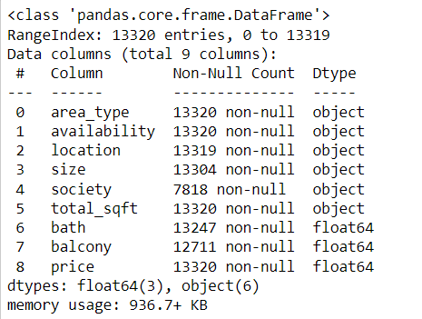
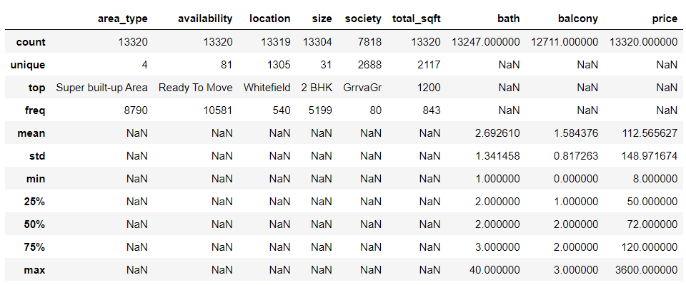
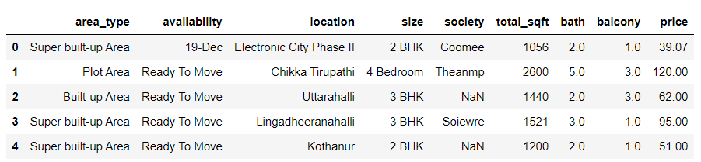
Raw Dataset
Here only bath, balcony and price is in the correct datatype by default
All description of the raw dataset
First 5 values of the dataset

Slide 5
Basic Data Preprocessing
Removed duplicated records and as well as null values from the data frame.
Converted the availability columns from a specific date to number of days left for availability.
Converted the size column from object datatype into BHK having only numeric values.
Deleted the society column as in further analysis it is observed as insignificant.
Cleaned the total_sqr column which was having ‘-’, ‘sq’ etc into only float datatypes.
Dropped the only 46 data which were null values left in total_sqft.
Filled the null values in Bath and Balcony using Iterative Imputer.
Aggregated a total of 1061 locations into the 'Others' category, which encompassed locations with a count of less than 11.
Used fuzzywuzzy algorithm to check the similarity between locations and grouped them further

Slide 6
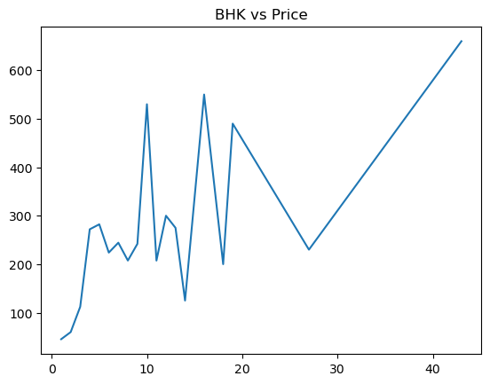
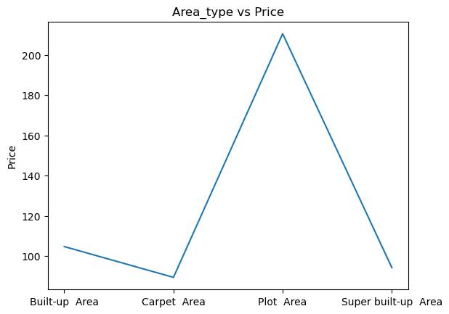
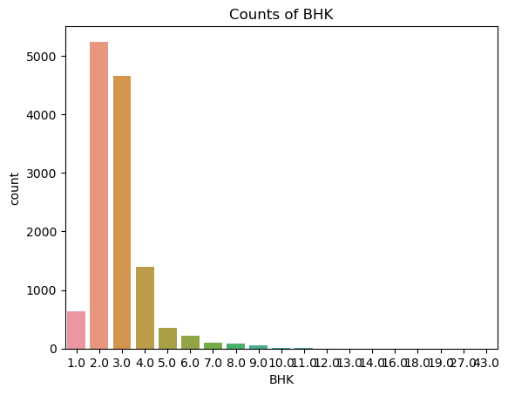
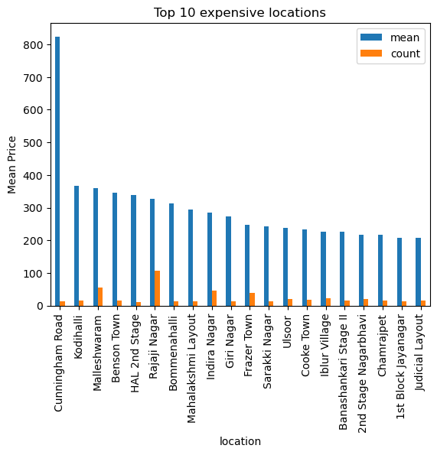
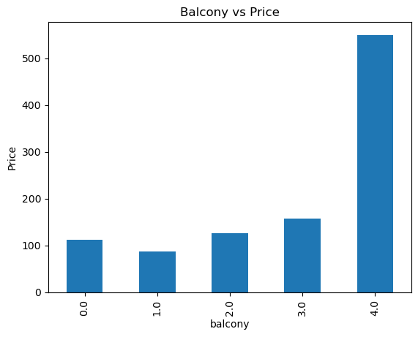
EDA
Here we can see that the price and BHK is in linear relationship , but still got lot of cleaning to be done
From here we identified that plot area is more expensive than the other area types in general
Counts of 2 and 3 BHK is the highest and after 9 BHK the data counts are significantly low
Location plays a major rule in determining the price of the property
Number of balconies also have a linear relationship with price

Slide 7


the base model
Linear regression score :
Random Forest Regression Score :
The scores are so bad, So we dig on more into Data cleaning and Data processing

Slide 8
Advanced data processing
Dropped data points having 0 square feet and also those having less than 250 sqfts per BHK.
Dropped data points having bathroom having more than 2 of BHK.
Dropped the outliers in price having values more or less than 1.5 times of standard deviation from the mean.
Dropped the data points with prices lower than the average price of properties with fewer bedrooms.
Dropped data points having BHK greater than 9 because the price of that doesn’t act as usual.

Slide 9
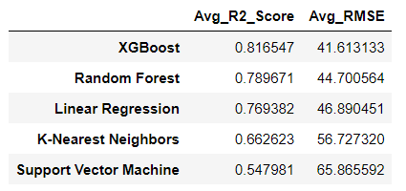
Finding The best model
Here we have run multiple algorithms 5 times with reshuffling and find out the average scores of it.
From this we identified that XGboost is the best algorithm to build the final model

Slide 10
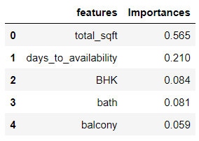
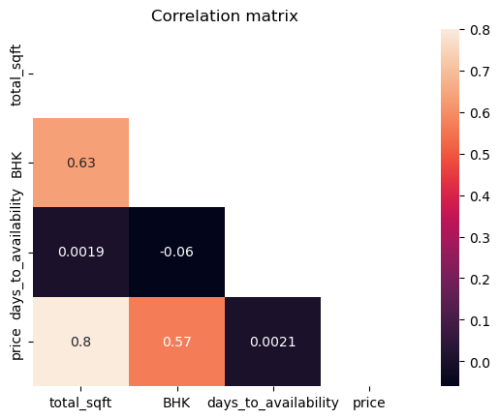
Feature engineering
Feature importance of the columns :
From this we identified that bath, balcony doesn’t got much significance so we drop it
From the correlation matrix we identifies that no further columns have multi collinearity, thus there isn’t any need for removing the other columns.

Slide 11

Building Final the model
We converted the locations and area _type into dummy variables through one-hot-encoding.
We have also did hyperparameter tuning using GridSearchCV
We then build the final model using XGBoost Regressor with the following scores :

Slide 12
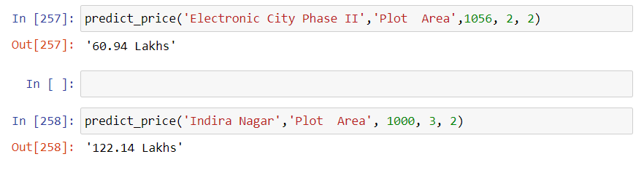
Implementation
We have then created a function called predict_price() to predict the price of our desired property
We have also created a function called list_of() to get the names of location and the area type list so that it will be easy for us to use that in the predict_price fuction
⬇️ Final Result 👇

Slide 13
Credits :
Google: For providing valuable resources and information used in this project.
YouTube: For hosting educational videos and tutorials that helped in learning and understanding key concepts.
Sreelakshmi ( my sis ): Civil Engineer and invaluable contributor, for her expertise, guidance, and support throughout the development of this property price prediction model.
OpenAI (ChatGPT): For providing assistance in programming and code-related aspects, making the development process easier and more efficient.

Slide 14
Thank You

